Slide 1


A Mini Project Presentation On “Railway Reservation System”
Department of Computer Science & Engineering
(Accredited by NBA 2024-2027) Buddha Institute of Technology, GIDA, Gorakhpur
B.Tech (3th sem), Session: 2024-25
Submitted By:
1.Hemant Singh
2.Atul Singh
3.Rupesh Kumar
Under the Guidance of:
Mr. Shashank kr. Srivastav
Assistant Professor
Department of Computer Science & Engineering
Buddha Institute of Technology,
Gorakhpur

Slide 2
INTRODUCTION
The Railway Reservation System is a software application developed to streamline the ticket booking and cancellation process for railway passengers.
It automates tasks such as booking tickets, managing reservation history, and handling cancellations.
The system is designed to be user-friendly and ensures a smooth interface for users to perform basic reservation operations.
Developed using C programming language
Uses basic concepts such as input/output operations,functions,arrays,structures,and file handling

Slide 3
OBJECTIVES
Ticket Booking: Users can enter personal and travel details to book train tickets.
Booking Confirmation: The system stores and confirms booking details for the user.
Ticket Cancellation: Allows users to cancel existing reservations by providing necessary information.
Display Current Bookings: Displays current booking status, including user and ticket details.
Booking History: Users can view their previous reservations for better management.
Data Management: Implement file handling to store and retrieve booking information persistently, even after the system is closed.

Slide 4
REQUIREMENT SPECIFICATION:
Minimum Hardware Requirement specification:
Processor: Intel Core i3
Ram:4GB(minimum)
Storage: 512GB SSD OR HDD
Minimum Software Requirement Specification:
Operating System: Windows 10
Dev-C++ : Compile and run the program

Slide 5
METHODOLOGY
Display Main menu |
1. Admin
2. User
3. Exit
Switch Case Condition
Structure
File Handling
Function
Cancel()
Add admin ()
Fair()
Passenger ()
Passenger
Train
Ticket

Slide 6
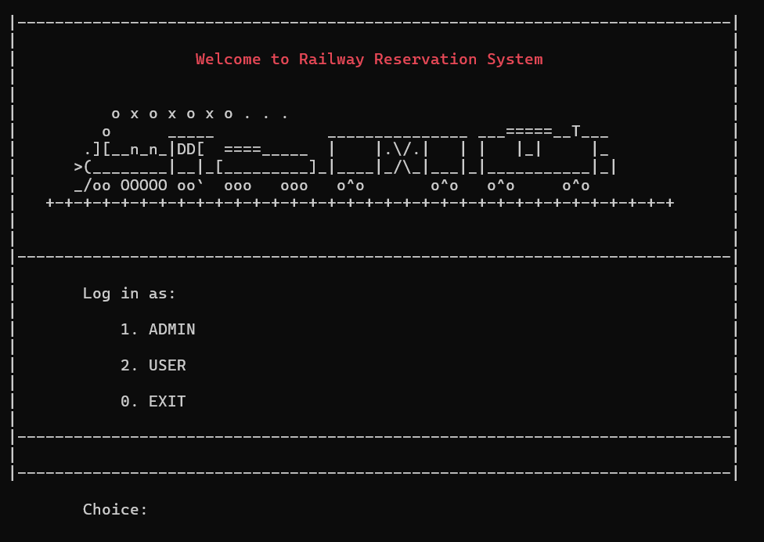
INTERFACE

Slide 7
EXPECTED OUTCOMES
Functional System: A fully functional railway reservation system that allows users to book, cancel, and view tickets.
System Efficiency: Fast and reliable handling of user requests without delays..
Booking Confirmation:The user receives a detailed bill, including their travel class, total fare, seat allocation, and other details.
Cancellation Success:Tickets are successfully canceled by seat number and the booking is removed from the system.
Booking History Display:Users can review past bookings with a clear list of passengers and their travel details.
Data Persistence:Booking data is stored in a file, allowing the system to maintain consistency across multiple uses.
User-Friendly Experience:The interface is simple and easy to use, ensuring that even users with minimal technical knowledge can operate it

Slide 8
REFERENCES
1.C Programming Language:
"Let Us C" book on C programming written by Yashavant Kanetkar.
2. Structures:
• GeeksforGeeks. (2023). Structures in C. Retrieved from C Structures - GeeksforGeeks
3. Random Number Generation
• cppreference.com. (2023). rand() and srand(). Retrieved from
rand - cppreference.com
4. Platform-Specific Functions
• Microsoft Docs. (2023). conio.h Functions. Retrieved from https://learn.microsoft.com/en-us/cpp/c-runtime-library/console-and-port-i- o?view=msvc-170
5. Projects and Repositories
https://github.com/v-hemanth/RailwayReservationSystem2.

Slide 9
THANK YOU

